Slide 1
C card churners data analysis
MENU
ANALYSIS
CONTACT
Group 3 (no pun indented)
Credit

Slide 2
Hello!
MENU
ANALYSIS
CONTACT
Data ANALYSIS
A presentation brought to you by:
No Pun Indented

Slide 3
INTRODUCTION
MENU
ANALYSIS
CONTACT
Data ANALYSIS
We will be analyzing a data set of customer information from a bank that is concerned about the high churn rate. Credit Card churning is the practice of repeatedly opening and closing credit card accounts to continually receive the incentives that are given to those who open new credit card accounts. We will be performing exploratory data analysis on this dataset, to see if we can gain any insight into which customers are more likely to churn and is there anyway of decreasing that number.

Slide 4
CONTENTS
MENU
ANALYSIS
CONTACT
Data ANALYSIS
Where did we find the dataset and how did we use it to answer our questions?
What questions are we asking and why?
The clean up and EDA process
Our conclusions and their implications

Slide 5
The Data
The dataset we were working with was from Kaggle (although originally from leaps.analyttica.com) and was comprised of information of customers who were under the banks’ credit card services.
The dataset consists of over 10,000 customers and hosts a wide variety of information.
This allowed us to look at several relationships within the data to identify any possible trends, that may allow us to predict which customers are more likely to churn.

Slide 6
Key questions
MENU
ANALYSIS
CONTACT
Can we compare gender and age to the attrition status of customers, to identify any trends?
How does the familial situation affect the attrition status of customers? Can we use gender, age, marital status and dependents to identify any correlation between familial situation and attrition status?
Does how long the customer has been inactive give any indication to whether a customer may leave? Using months inactive and months on book, can we recognize what may be a trigger point for customers leaving?
Is there a relationship between education and income levels - do higher education and income correlate? Are those with a higher income and higher education level more likely to stay with the bank? Are people with a lower income more likely to leave? (Does a high number of dependents and low income have any effect?)
What is the relationship between card category and income? Are those with a higher income on a better card, and are those on better cards more likely to stay or leave?
Do customers on higher income have higher transaction levels? Is there any correlation between transaction amounts and how long customers have been inactive?

Slide 7
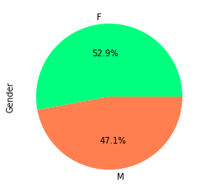
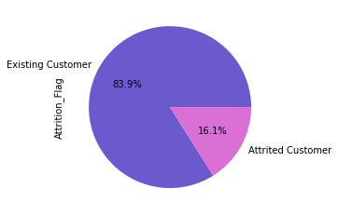
Question 1
The first question we looked at was to identify if there were any trends between customer age, gender and attrition status. We first used pie charts to allow for easy visualization. (They are nice to look at)

Slide 8
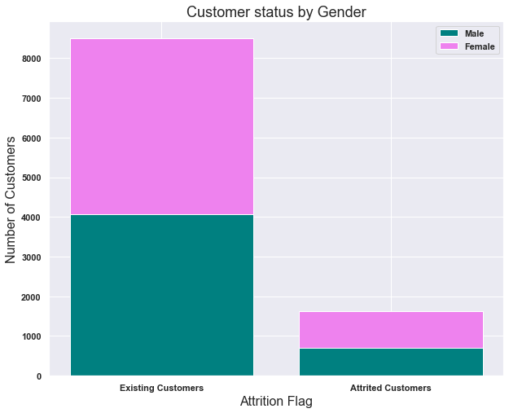
Question 1 cont.
We then created a stacked column chart to allow for comparison between the genders and the attrition status.

Slide 9
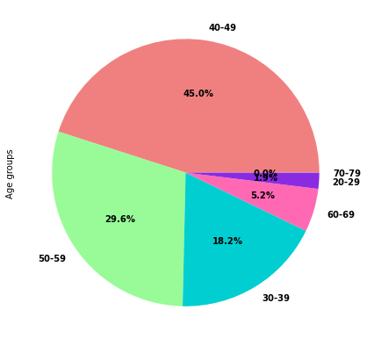
Question 1 cont. again
We then looked at the customer ages, by putting them in the bin. We first visualized the age groups with a pie chart.

Slide 10
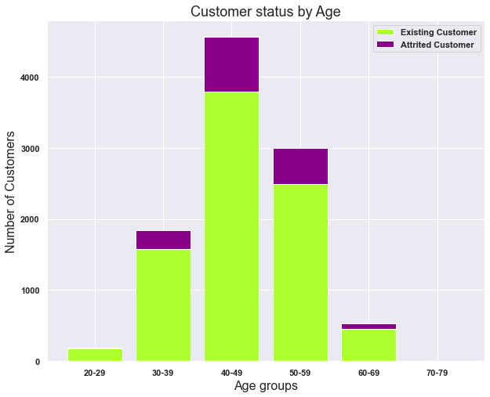
Question 1 cont. again
We then created a stacked column chart looking at the attrition status within the different age groups.

Slide 11
Question 1 conclusions
So, what do these visualizations tell us and what conclusions can we draw from this?

Slide 12
Question 2

Slide 13
Question 2 cont.

Slide 14
Question 3
The third question we are looking at is whether how long a customer has been inactive and how long they have been with the bank can give any indication of when a customer may leave.

Slide 15
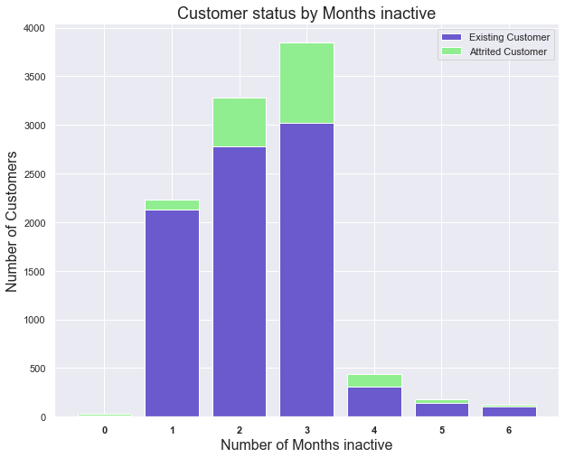
Question 3 cont.
We then created a stacked column chart to show the status of customers sorted by the months inactive.

Slide 16
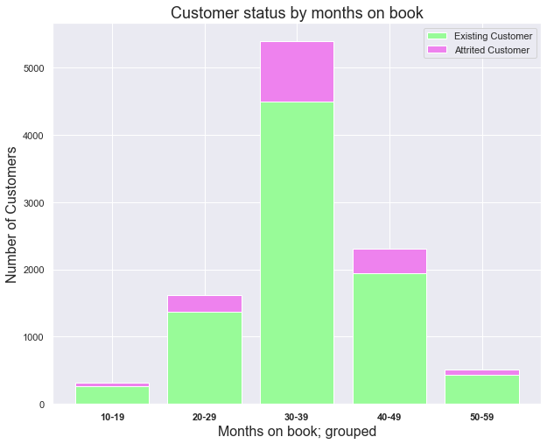
Question 3 cont.
We then created a stacked column chart to show the status of customers sorted by the months on the book.

Slide 17
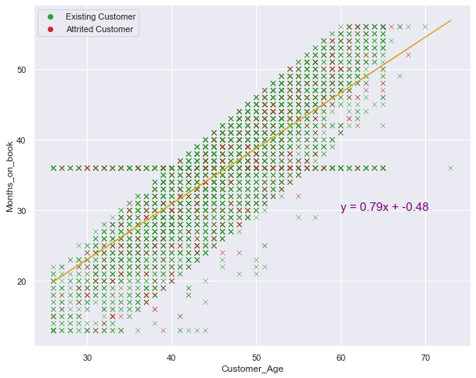
Question 3 conclusions
So, what do these visualizations tell us and what conclusions can we draw from this?
Featuring the ugliest scatter plot I’ve ever made

Slide 18
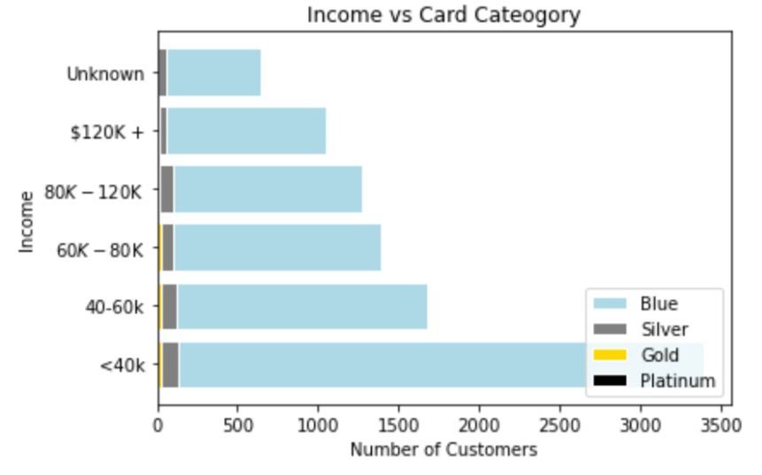
Question 5
Card category comparison against income.
Blue: 93.2%
Silver: 5.5%
Gold: 1.1%
Platinum: 0.2%

Slide 19
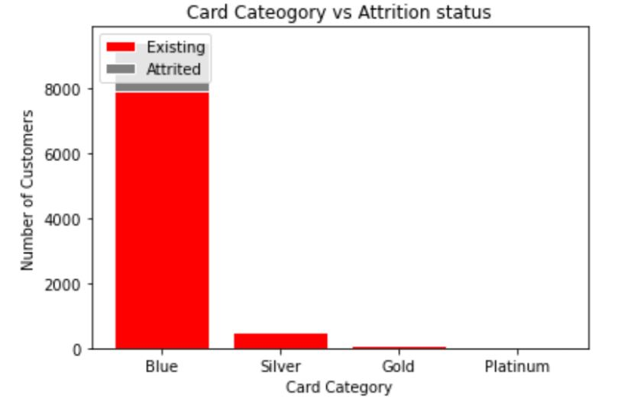
Question 5
Card category comparison against attrition.
EXISTING
Blue: 93.1%
Silver: 5.6%
Gold: 1.1%
Platinum: 0.2%
ATTRITED
93.4%
5.0%
1.3%
0.3%

Slide 20
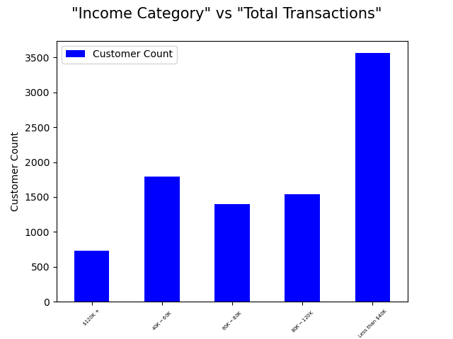
Question.6
Do customers on higher income have higher transaction levels? Is there any correlation between transaction amounts and how long customers have been inactive?
In the first part we analyzed a relationship between the income level vs. the customers
What conclusion we draw here?

Slide 21
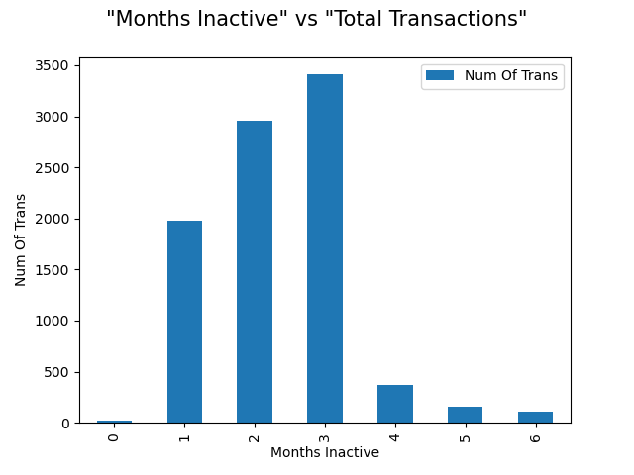
Question 6 CoNT
In the second part, a bar graph was created to show a relationship between the
In the second part we analyzed a relationship between number of transactions and Months Inactive.
What conclusion we draw here?

Slide 22
and Visualisation
MENU
ANALYSIS
CONTACT
Data ANALYSIS
analysis

Slide 23
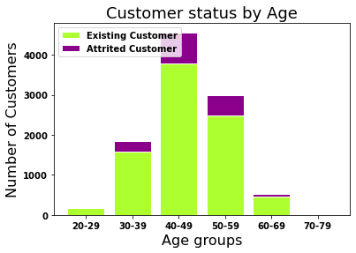
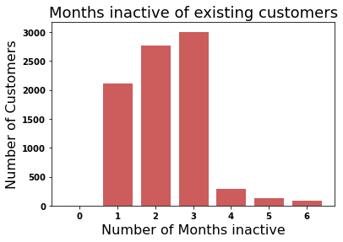

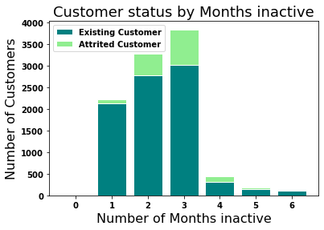
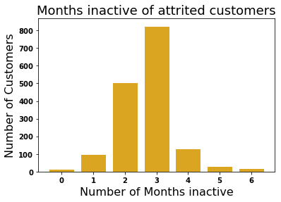
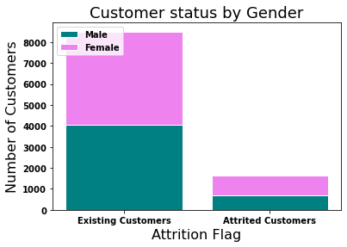
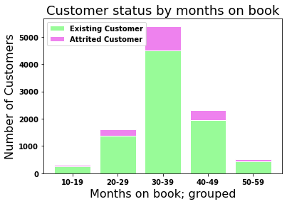
Q1: *insert q later*
MENU
ANALYSIS
CONTACT
Data ANALYSIS

Slide 24
Insert map from api her if we get there
MENU
ANALYSIS
CONTACT
Data ANALYSIS

Slide 25

METHODS, TECHNIQUES AND TOOLS
MENU
ANALYSIS
CONTACT
Data ANALYSIS
Do you know what helps you make your point clear? Lists like this one:
They’re simple
You can organize your ideas clearly
You’ll never forget to buy milk!
And the most important thing: the audience won’t miss the point of your presentation

Slide 26
DATA PROCESSING
MENU
ANALYSIS
CONTACT
Data ANALYSIS
NEPTUNE
JUPITER
VENUS
It’s the farthest planet from the Sun
CERES
Venus is the second planet from the Sun
MARS
saturn
Mars is actually a very cold place
mercury

Slide 27
THANKS!
MENU
ANALYSIS
CONTACT
Data ANALYSIS
Do you have any questions?
youremail@freepik.com
+91 620 421 838
yourcompany.com
Please keep this slide for attribution

Slide 28
Any questions
MENU
ANALYSIS
CONTACT
Data ANALYSIS

Slide 29
METHODOLOGIES
10%
25%
20%
45%
MENU
ANALYSIS
CONTACT
Data ANALYSIS
Venus is the second planet from the Sun
Jupiter is the biggest planet of them all
It’s the closest planet to the Sun
Mars is actually a very cold place

Slide 30
BUDGET
MENU
ANALYSIS
CONTACT
Data ANALYSIS
VENUS
Venus is the second planet from the Sun
$ 1,300.000
$ 30,000
$ 9,000
MERCURY
MARS
Mercury is the closest planet to the Sun
Despite being red, Mars is a cold place

Slide 31
ANALYSIS RESULTS
MENU
ANALYSIS
CONTACT
VARIABLE | MODEL 1 | MODEL 2 | MODEL 1 | MODEL 3
Despite being red, Mars is actually a very cold place | –0.234 | 0.836 | –0.742 | 0.600
Venus is the second planet from the Sun in the Solar System | –0.135 | 0.642 | –0.982 | –0.102
Mercury is the closest planet to the Sun and the smallest one | –0.309 | 0.752 | 0.173 | 0.500
Jupiter is a gas giant and the biggest planet in the Solar System | 0.604 | –0.378 | 0.402 | 0.109

Slide 32
THIS IS A TABLE
MENU
ANALYSIS
CONTACT
Data ANALYSIS
SEARCH TERM | SUM OF IMPRESSIONS | TOTAL COST | RETURN
Term 2387 | 109 | $ 898,982 | 8265 %
Term 4028 | 222 | $ 1,982.000 | 2987 %
Term 3105 | 245 | $ 123,49 | 4087 %
Term 2098 | 154 | $ 120,000 | 1287 %

Slide 33
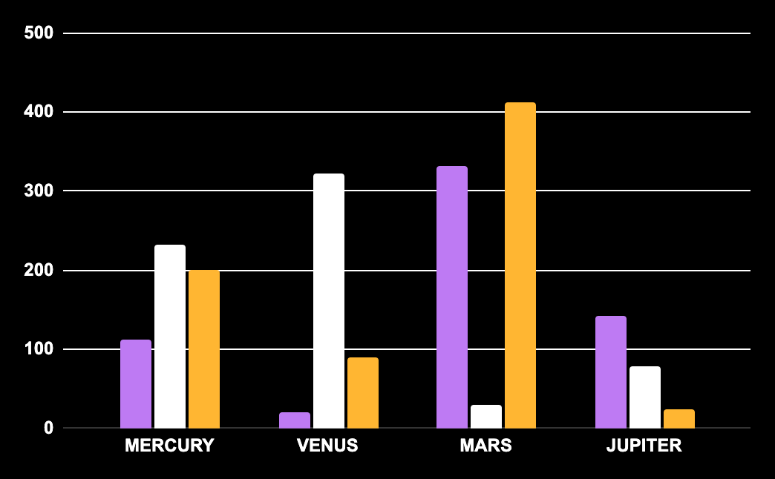
RISK ANALYSIS
MENU
ANALYSIS
CONTACT
Data ANALYSIS
MARS
Mars is actually a cold place. It’s full of iron oxide dust
NEPTUNE
It’s the farthest planet from the Sun. It's also the fourth-largest
venus
Follow the link in the graph to modify its data and then paste the new one here. For more info, click here
It’s the second planet from the Sun in the Solar System

Slide 34
Fonts & colors used
This presentation has been made using the following fonts:
Bebas Neue
(https://fonts.google.com/specimen/Bebas+Neue)
Arimo
(https://fonts.google.com/specimen/Arimo)
#ffffff
#0e166c
#921d87
#ffb632
#ffe485
#be7af3
#51127c

Slide 36
JANUARY
FEBRUARY
MARCH
APRIL
MAY
JUNE
PHASE 1
Task 1
Task 2
PHASE 2
Task 1
Task 2
JANUARY
FEBRUARY
MARCH
APRIL
PHASE 1
Task 1
Task 2

Slide 39
...and our sets of editable icons
You can resize these icons without losing quality.
You can change the stroke and fill color; just select the icon and click on the paint bucket/pen.
In Google Slides, you can also use Flaticon’s extension, allowing you to customize and add even more icons.

Slide 40
Educational Icons
Medical Icons

Slide 41
Business Icons
Teamwork Icons

Slide 42
Help & Support Icons
Avatar Icons

Slide 43
Creative Process Icons
Performing Arts Icons

Slide 44
Nature Icons

Slide 45
SEO & Marketing Icons

Slide 46


